Slide 1
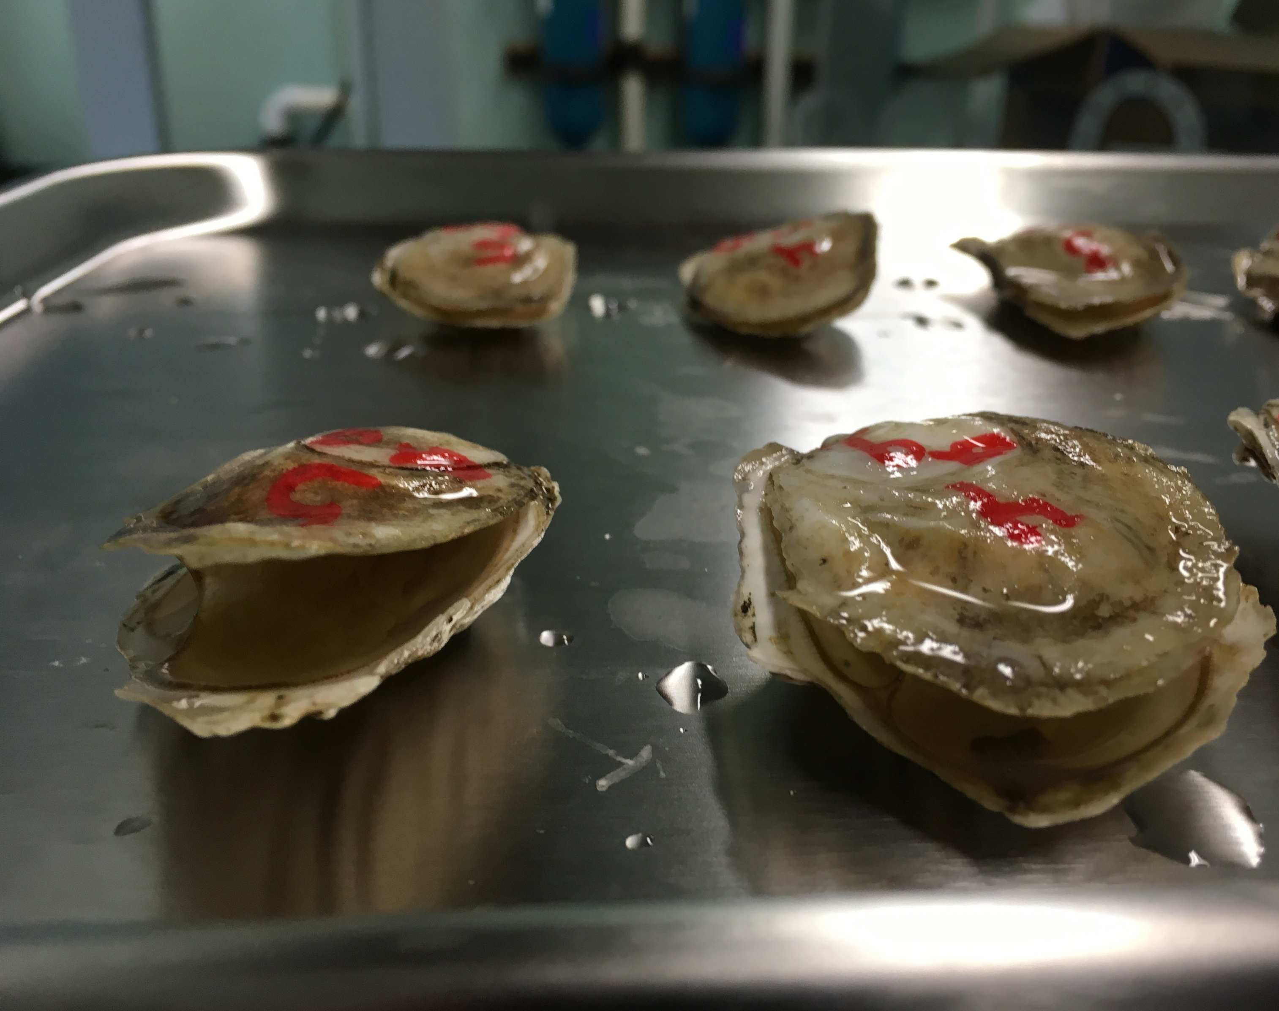
Non-destructive sampling of eastern oyster, Crassostrea virginica mantle tissue
Kathryn Markey Lundgren and Dina Proestou
USDA ARS Shellfish Genetics Lab
NACE Oyster Genomics Workshop
January 10, 2024

Slide 2
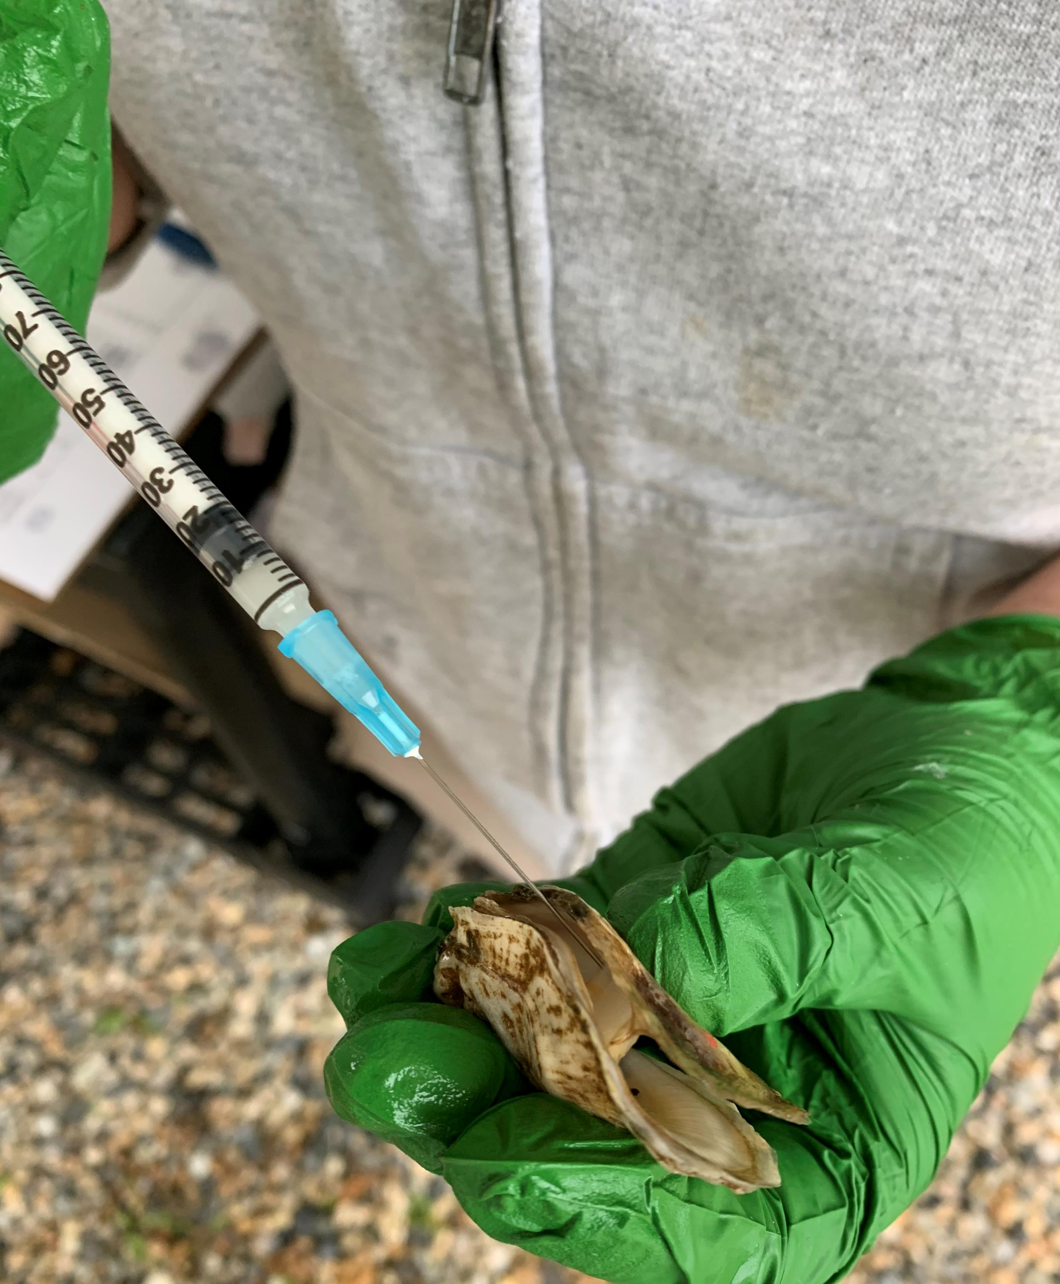
Background
In 2019 the USDA ARS Shellfish Genetics lab developed a simple non-destructive sampling method for oyster tissue
Can be used for a variety of applications
Physiological:
Observe gonad development during broodstock conditioning
Pathological:
Injection of pathogens
Track pathogen load in disease-challenged animals
Genomic:
Genotype selected oysters for estimating breeding values

Slide 3
Methods
2-day protocol
Day 1
Day 2
45-60 minutes of air exposure on trays
Remove oysters from anesthetic bath & place on trays
5% (w/v) Epsom Salt bath (15ppt seawater) overnight w/ air
Gently remove ~4-7mm of mantle tissue with scalpel & forceps
Return oysters to tank for recovery

Slide 4
Carefully cut a small (4-7mm) section with scalpel and remove with forceps
Place tissue into 95% ethanol or RNAlater
After 24 hrs in solution, DNA or RNA can be extracted
In most situations the entire biopsy will be needed to recover sufficient DNA/RNA yields

Slide 5
Validation:
Treatment | # reps | #/rep
Control (CONT) | 3 | 5-10
Epsom only (E) | 3 | 20
Epsom + biopsy (EB) | 3 | 70

Slide 6
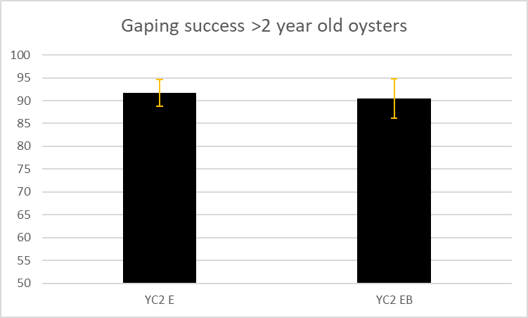
Gaping Success Data

Slide 7
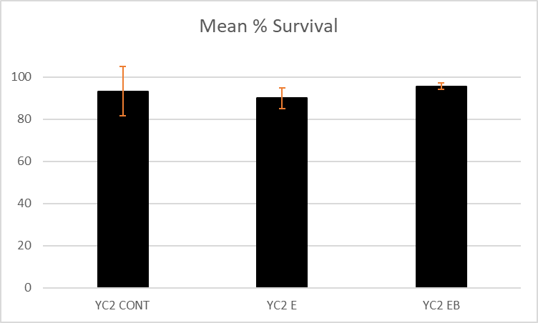
Survival

Slide 8
Once we determined this method to be safe and reliable, we decided to use it for all dermo challenges

Slide 9
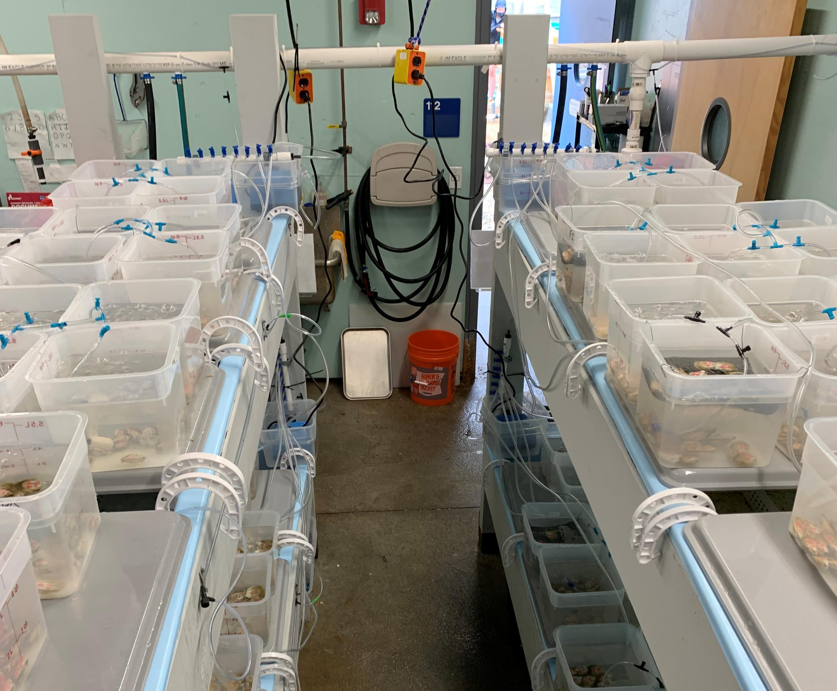
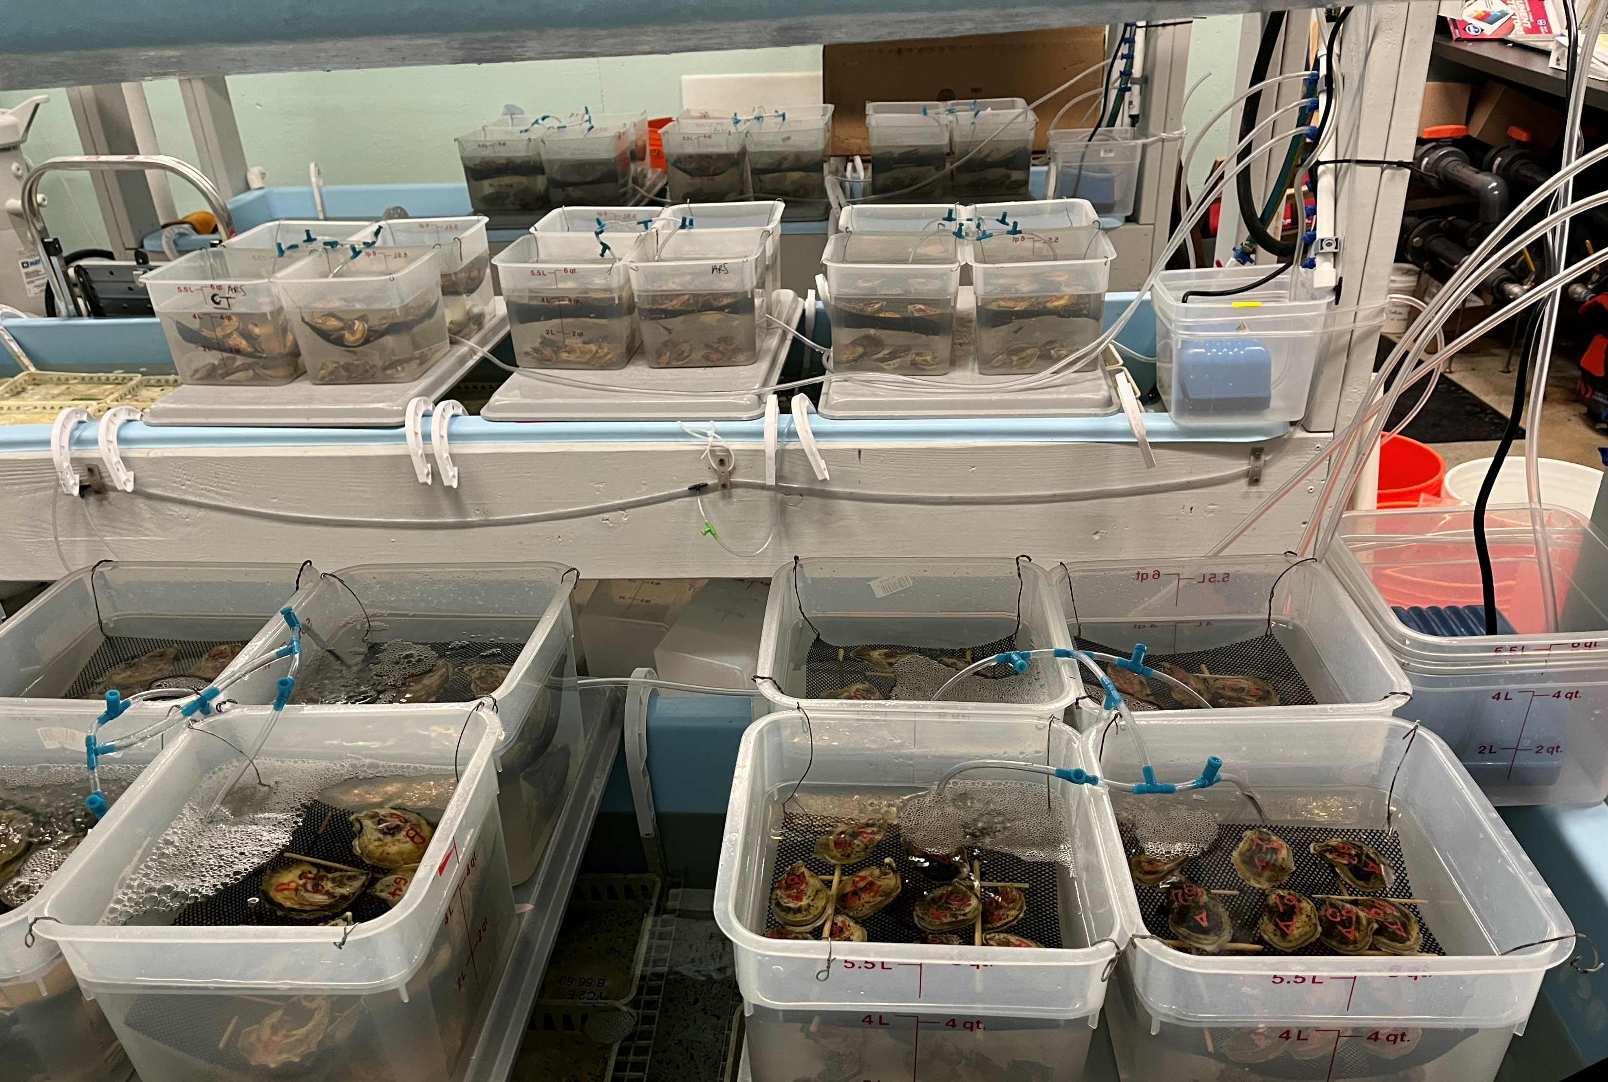
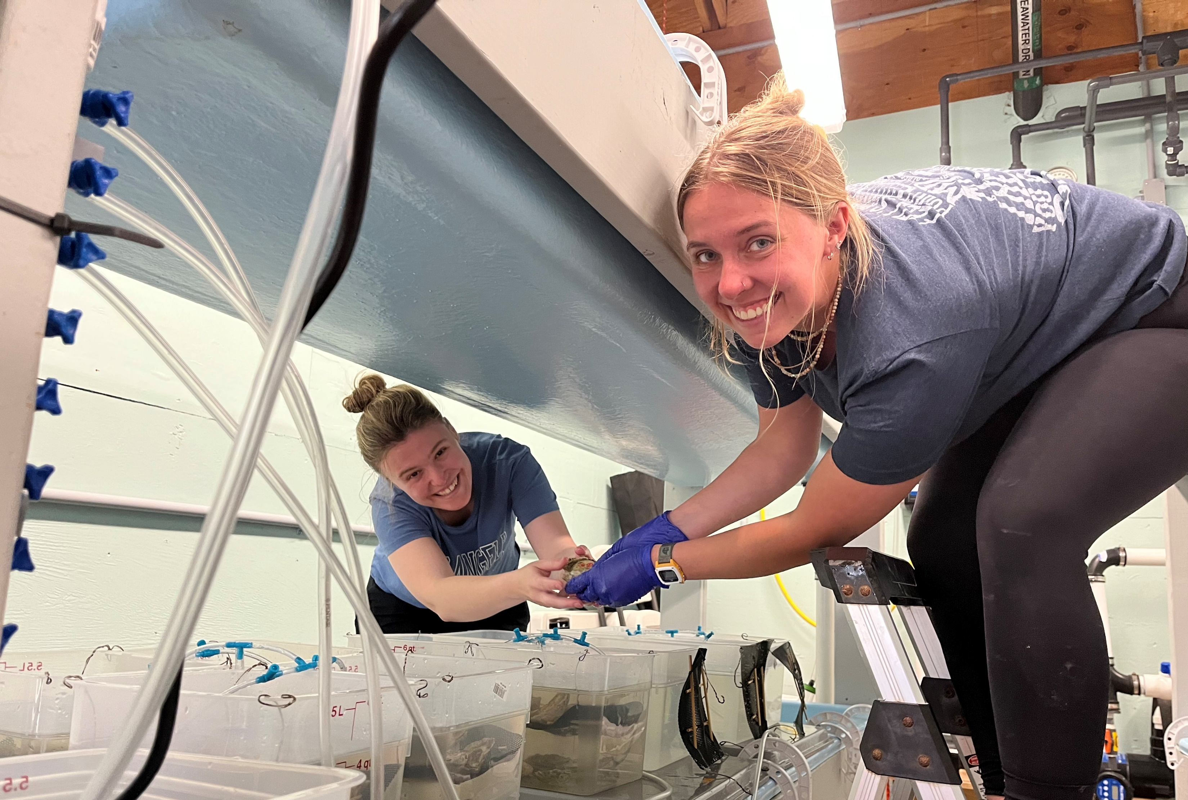

Slide 10
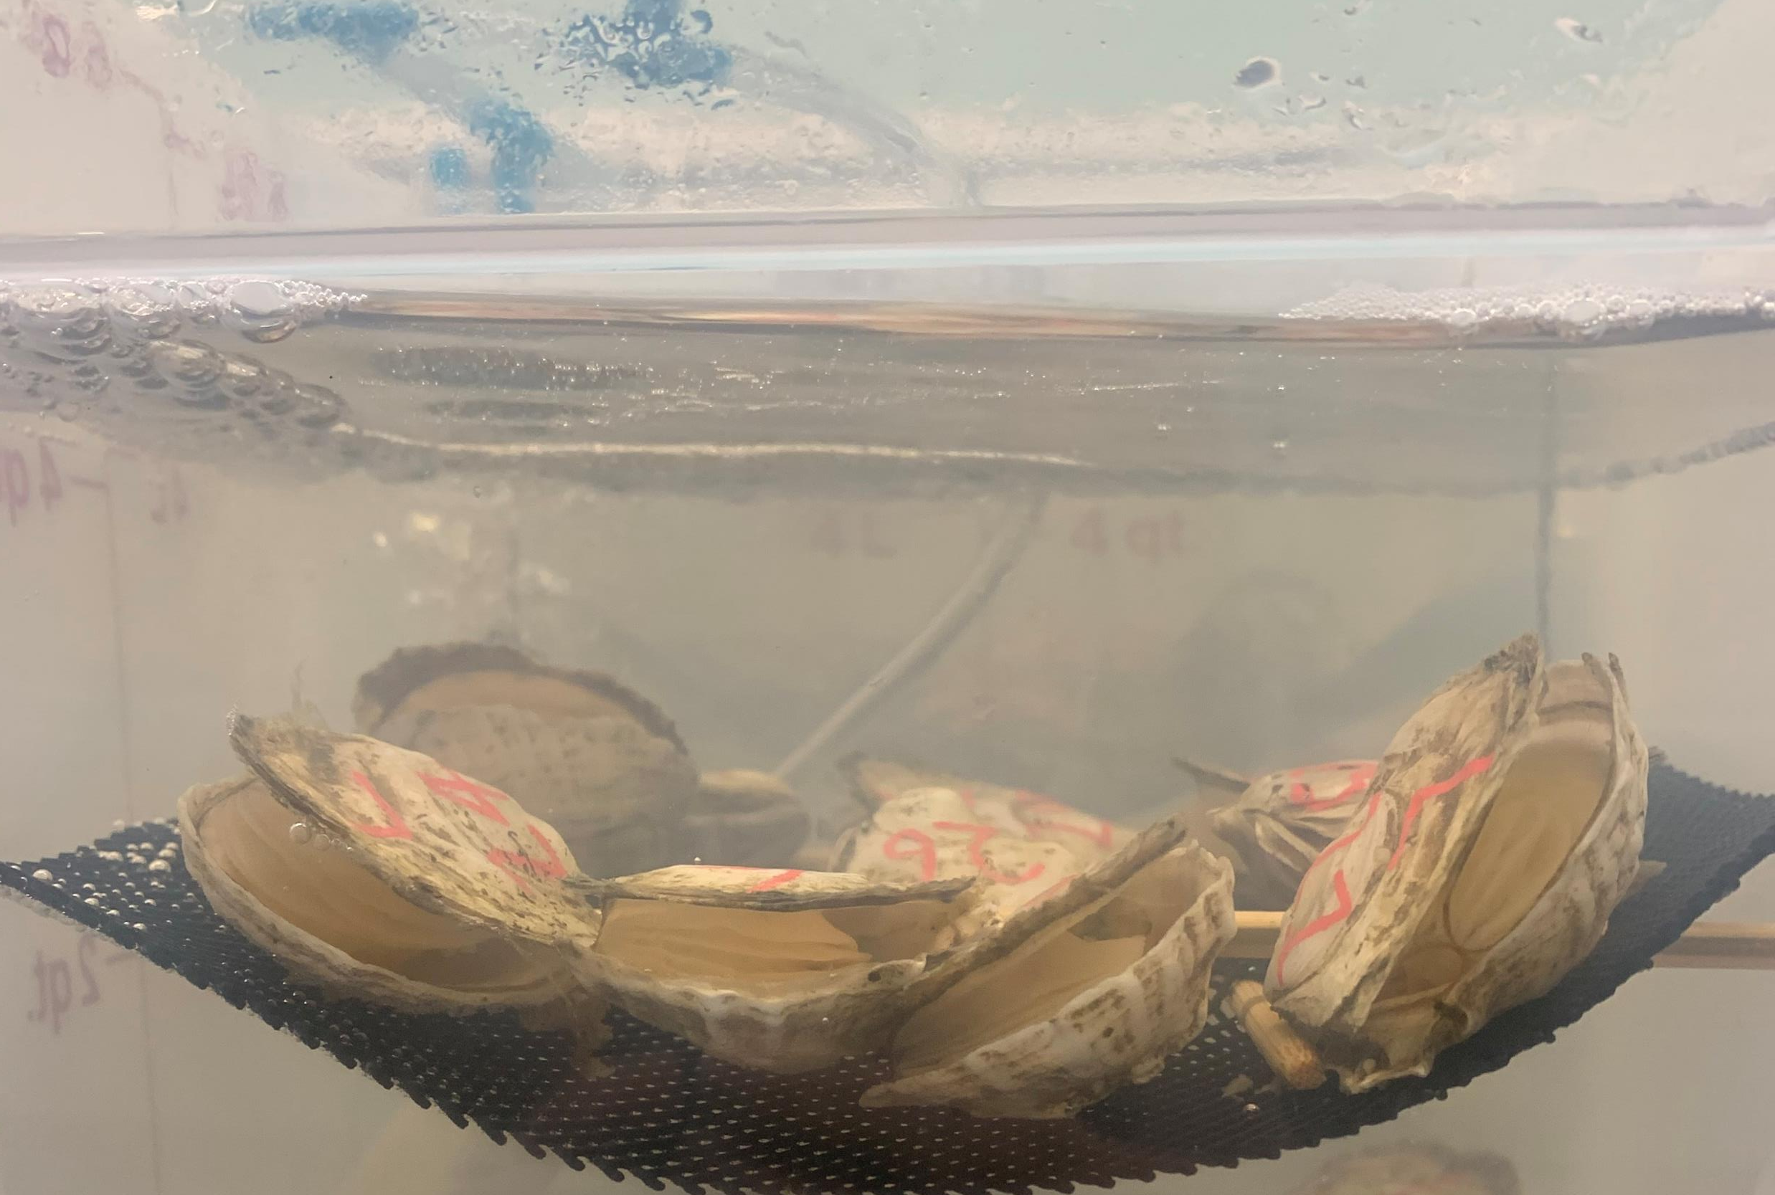
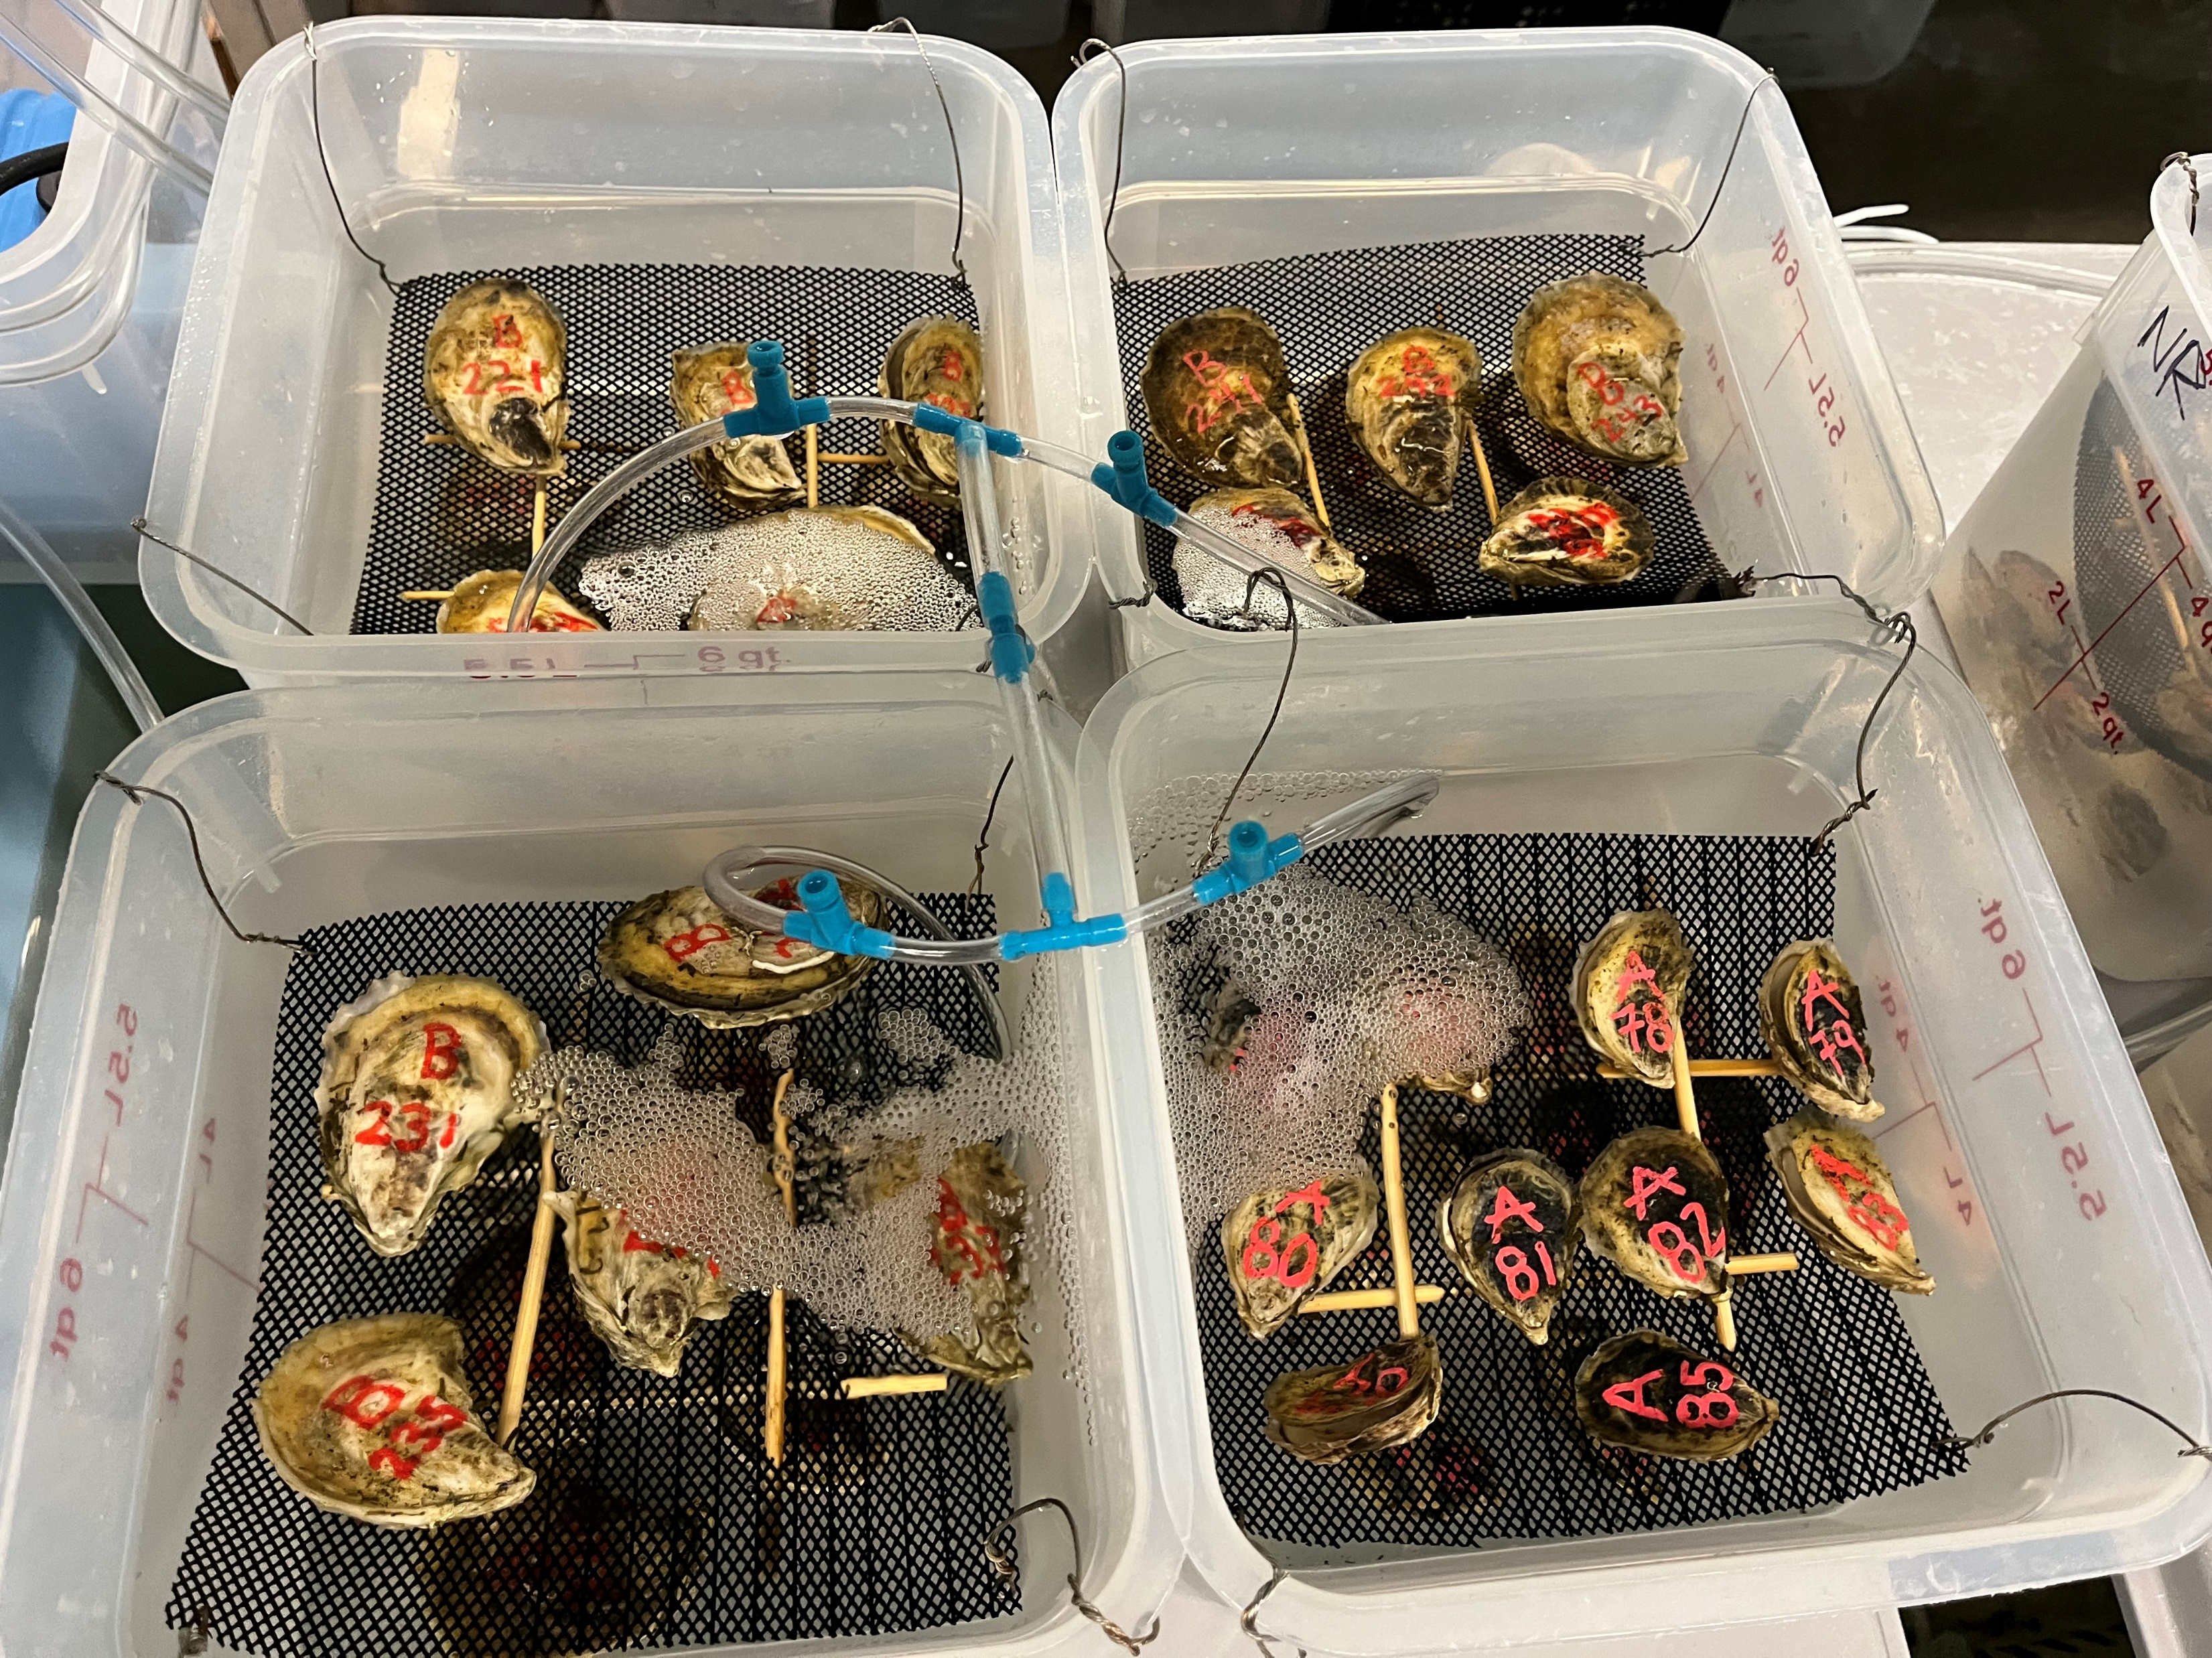
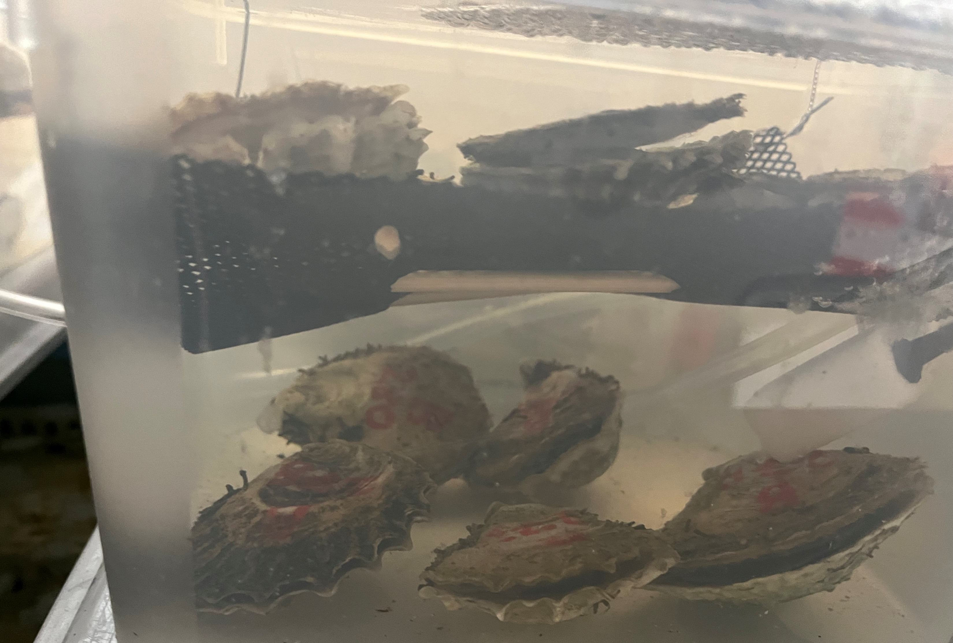

Slide 11
Large-scale anesthesia

